Slide 1
Restoring Trust by Computing: Data-driven Fact-checking and Exceptional Fact Finding
Chengkai Li
Associate Professor and Associate Chair
Innovative Database and Information Systems (IDIR) Lab
CSE Department, UT-Arlington
QCRI
February 18, 2019

Slide 2
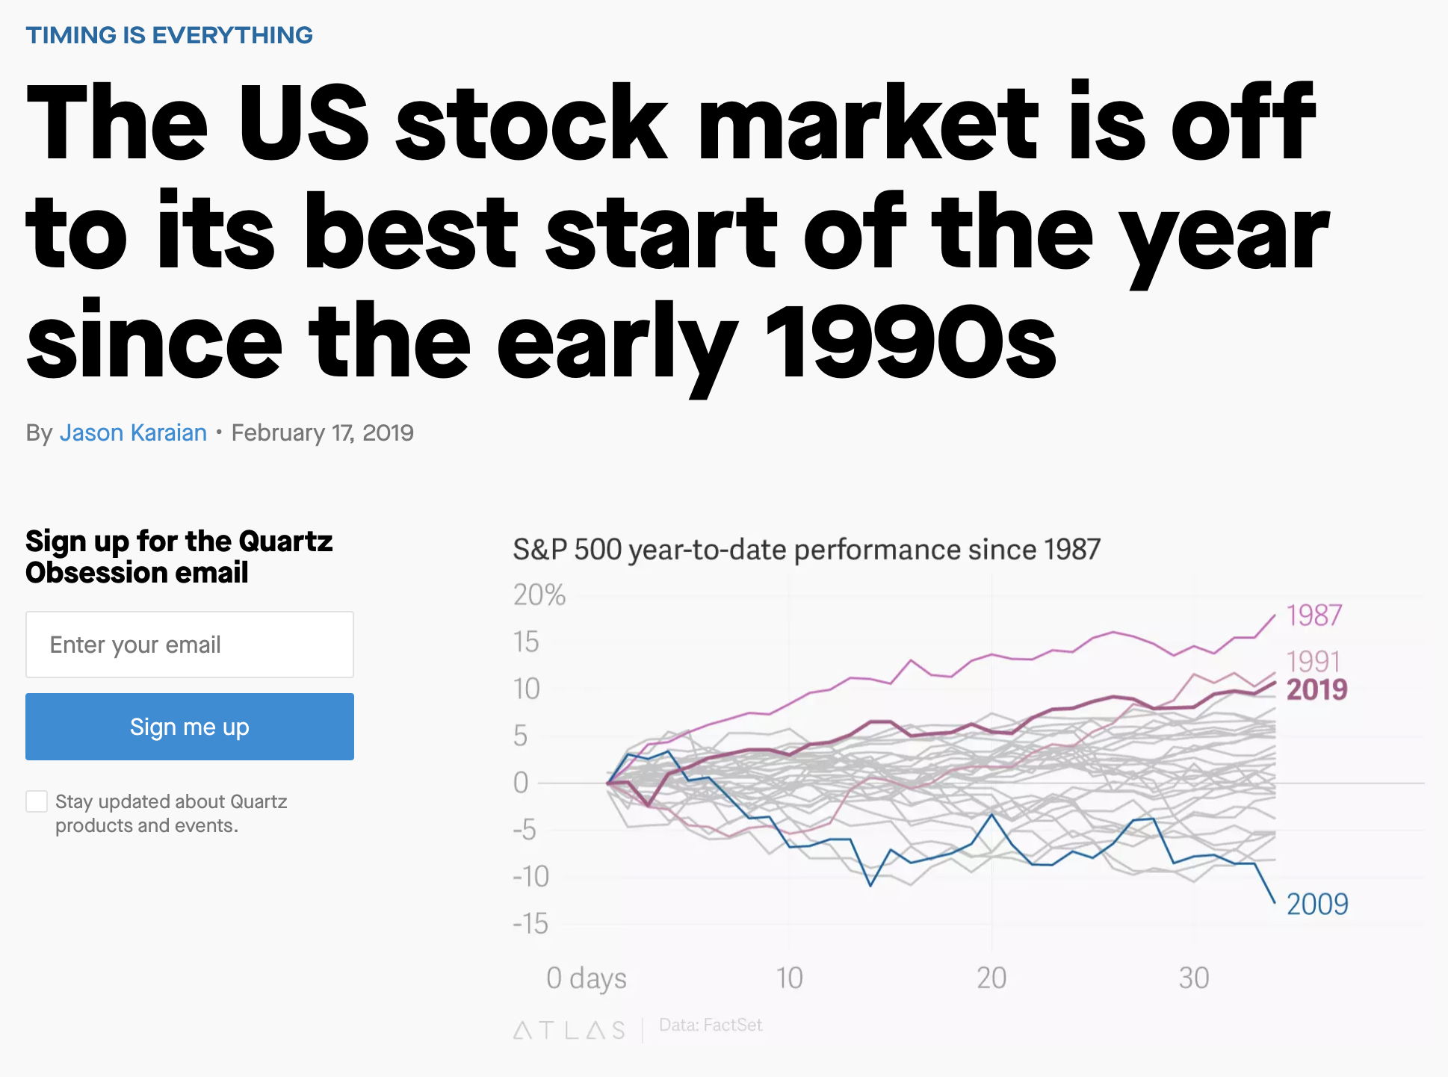

Slide 3
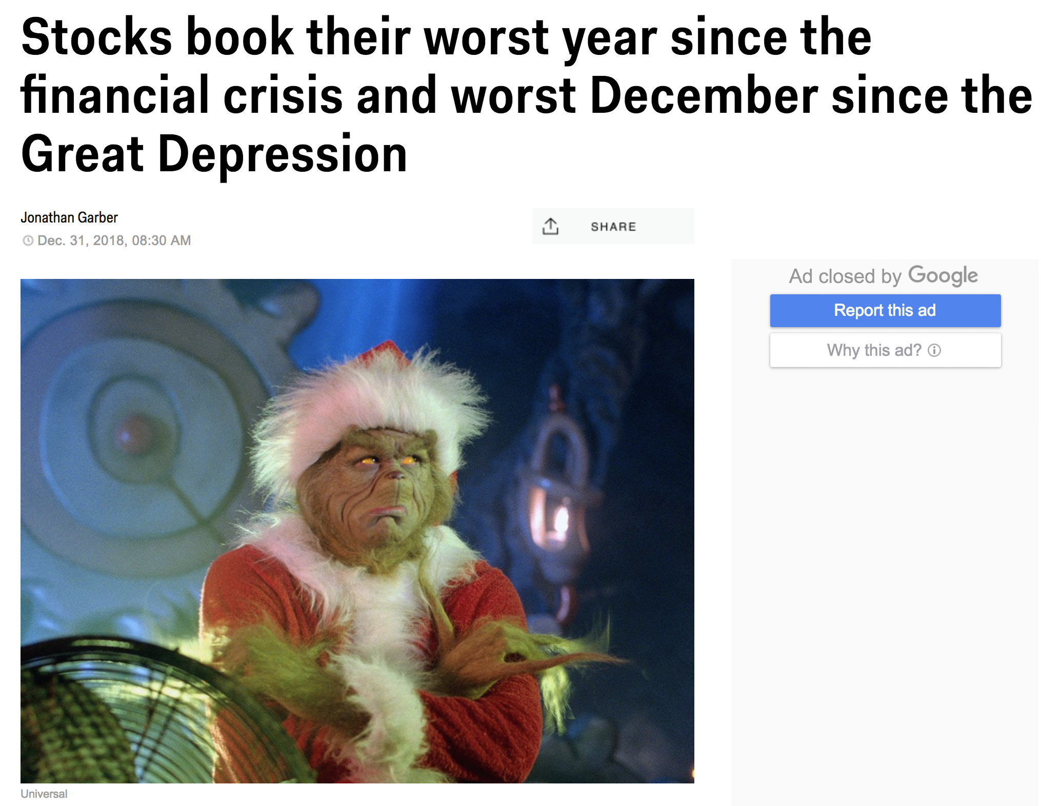

Slide 4
Outline
A Brief History of our Computation+Journalism Research
Computational Journalism
Data-driven fact-checking (ClaimBuster)
Other ongoing fact-checking Projects
Exceptional fact finding (FactWatcher, Maverick)
Graph Data Usability (Orion, GQBE, TableView, Maverick)

Slide 5
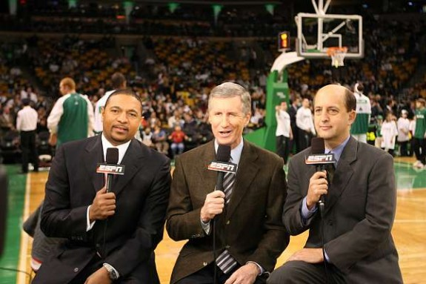

How it Started
2009
Chris Paul had 16 points, 10 rebounds, 13 assists and five steals…… The only other active player to have such a game is Jason Kidd…
How did they come up with that?

Slide 6
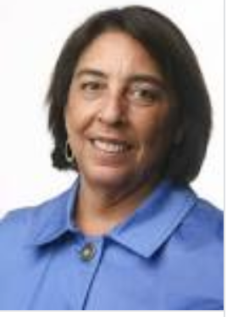
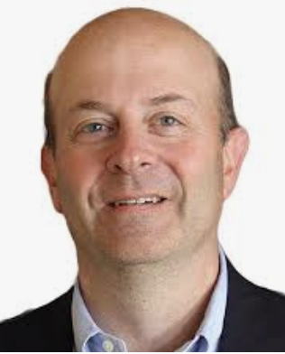
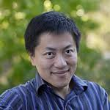
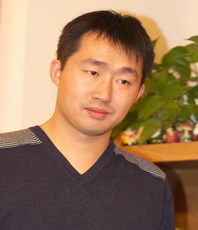
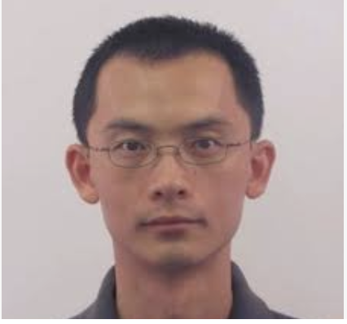
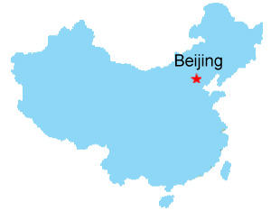

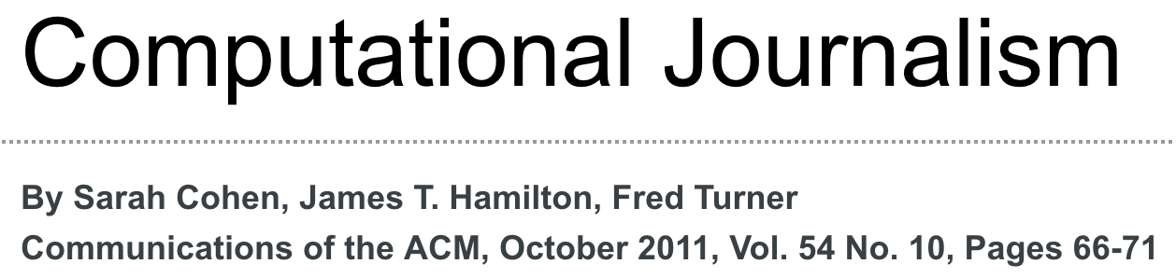
How it Started
“Developing the Field of Computational Journalism” Workshop, July 27-31, 2009
Let’s work on this fact-finding problem.
This is computational journalism.
Summer 2010
#@%&!#!%

Slide 7

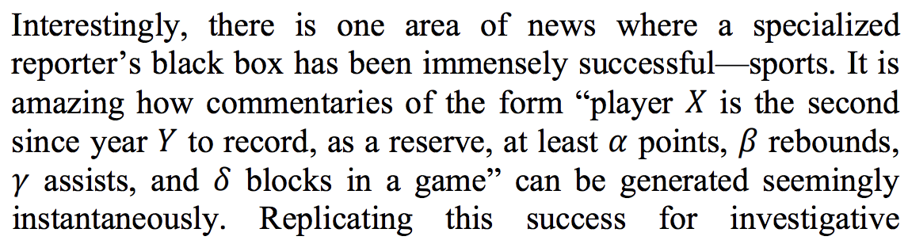
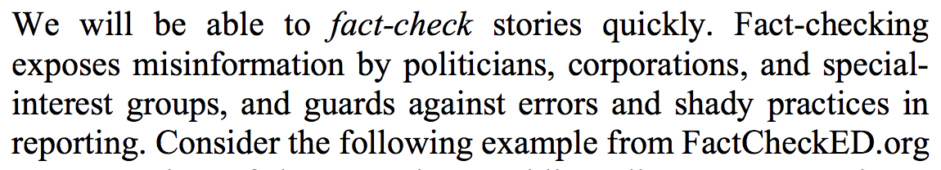
CIDR 2011
fact-finding
fact-checking

Slide 8
The “Fake News” Problem
It was always there, since “Yellow Journalism” started in 1890s.
Exaggerated headlines, clickbait, computational propaganda, misinformation, disinformation
Snopes.com (1994), Glenn Kessler (1996), FactCheck.org (2003), PolitiFact (2007)
But it became a daily talking point since 2016.
Pizzagate
“filter bubble” and “echo chamber” exacerbated by social media
The many false claims in political discourses
Russian meddling with U.S. election
Twitter bots, Facebook ads, trendy topic algorithms

Slide 9
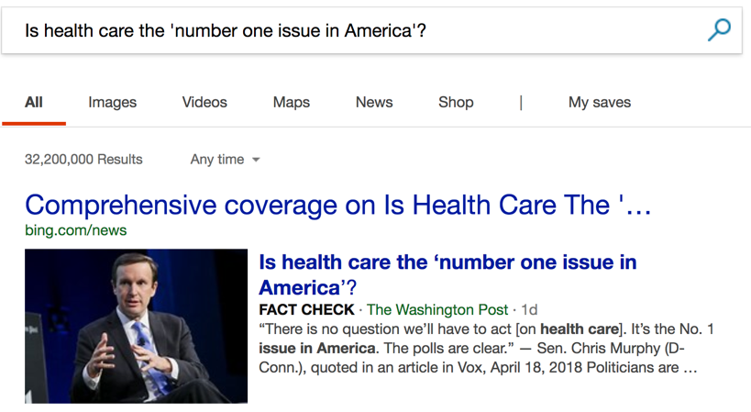
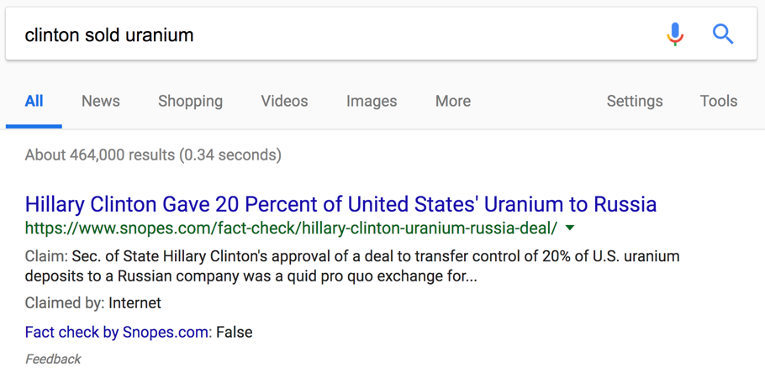
Fact-checks in Search Results

Slide 10
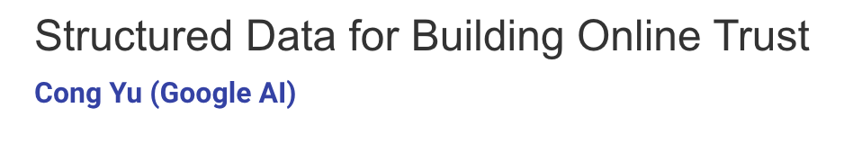

More Accounts of this Research
Cong’s VLDB18 Keynote

Slide 11
Outline
A Brief History of our Computation + Journalism Research
Computational Journalism
Data-driven fact-checking (ClaimBuster)
Other ongoing fact-checking Projects
Exceptional fact finding (FactWatcher, Maverick)
Graph Data Usability (Orion, GQBE, TableView, Maverick)

Slide 12


Toward the Holy Grail of Automated Fact-checking
idir.uta.edu/claimbuster
12

Slide 13
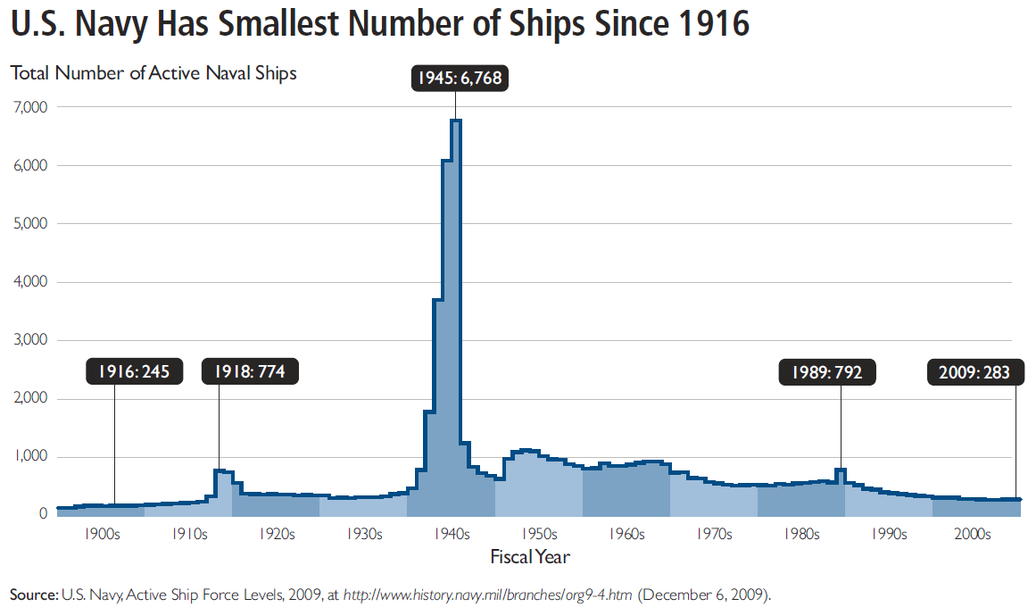
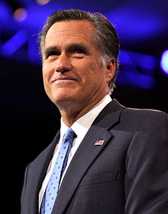
Fact-checking is Hard
“… our Navy is smaller than it's been since 1917", said Republican candidate Mitt Romney in third presidential debate in 2012.
http://en.wikipedia.org/wiki/Mitt_Romney
http://s3.amazonaws.com/thf_media/2010/pdf/Military_chartbook.pdf

Slide 14

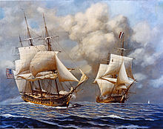
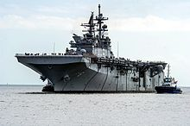
Fact-checking is Hard
“… our Navy is smaller than it's been since 1917", said Republican candidate Mitt Romney in third presidential debate in 2012.
vs
http://en.wikipedia.org/wiki/Mitt_Romney
http://s3.amazonaws.com/thf_media/2010/pdf/Military_chartbook.pdf
http://en.wikipedia.org/wiki/United_States_Navy

Slide 15
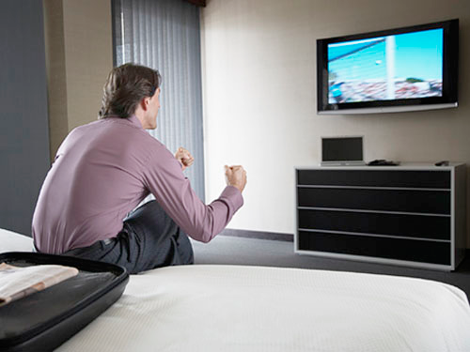
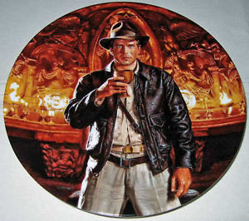
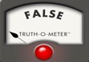

The Holy Grail: Automated, Live Fact-Checking
Source: Bill Adair

Slide 16
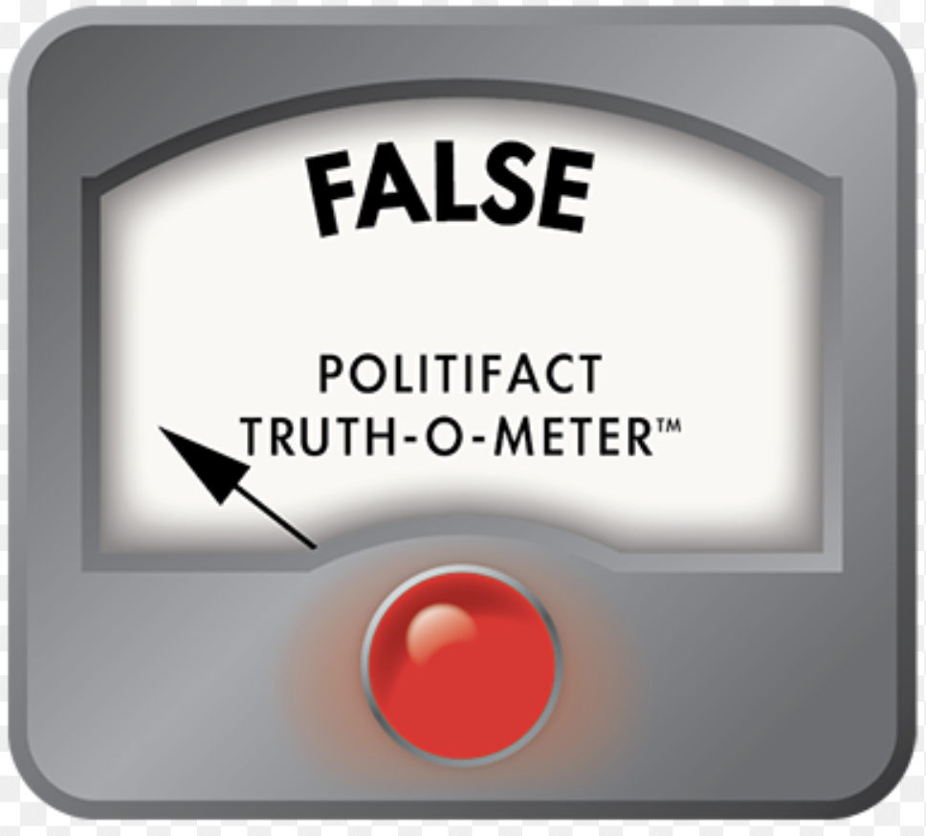
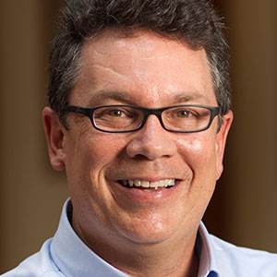
How ClaimBuster Started
Sarah Cohen and James Hamilton left Duke
Bill Adair joined Duke in 2013
NSF grant (Duke, UTA, Stanford) received in 2014. Monthly project meeting

Slide 17
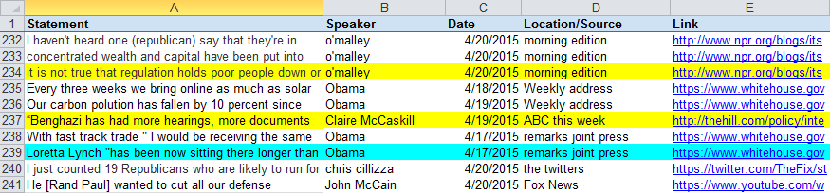
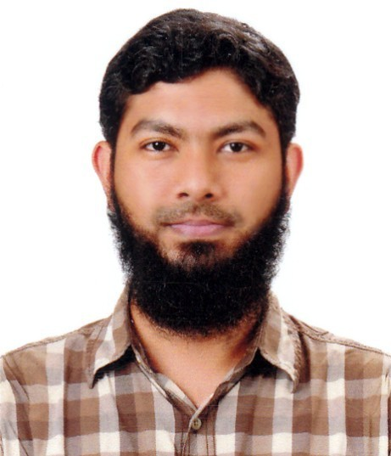
PolitiFact “Buffet” of Factual Claims
2014
This is what they eat at PolitiFact.
Naeemul Hassan started to work on its automation.

Slide 18

Claim Spotter
18

Slide 19





Finding Important Factual Claims:
A Supervised Learning Task
2016
Presidential
Debates
Human Annotation
Feature Extraction
Learning Algorithm
Ground Truth
Feature Vectors
Presidential Debate Transcripts (1960-2012)
Important factual claims
19

Slide 20
Classification and Ranking by Check-worthiness
CFS: Important factual claims
“We spend less on the military today than at any time in our history.” “The President’s position on gay marriage has changed.” “More people are unemployed today than four years ago.”
UFS: Unimportant factual claims
“I was in Iowa yesterday.” “My mother enjoys cooking.” “I ran for President once before.”
NFS: No factual claims (opinions, questions & declarations)
“Iran must not get nuclear weapons.” “7% unemployment is too high.” “My opponent is wishy-washy.” “I will be tough on crime.” "Why should we do that?“ “Hello, New Hampshire!” “Our plan is to reduce tax rate by 10%.”
20

Slide 21
Our Own CrowdFlower
21

Slide 22
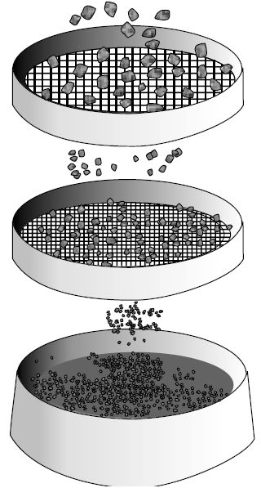
Ground Truth Collection
20788 sentences
374 coders
76552 labels
20 months, 374 coders, ~$4,000 paid
30 training sentences
1032 screening sentences (731 NFS, 63 UFS, 238 CFS) to detect spammers & low-quality coders
86 top-quality coders
52333 labels
Class | Count | Percentage
CFS | 4849 | 23.52%
UFS | 2097 | 10.17%
NFS | 13671 | 66.31%
Majority voting
20617 admitted sentences
http://www.engineersdaily.com/2014/03/basics-of-soil-compaction.html
22

Slide 23
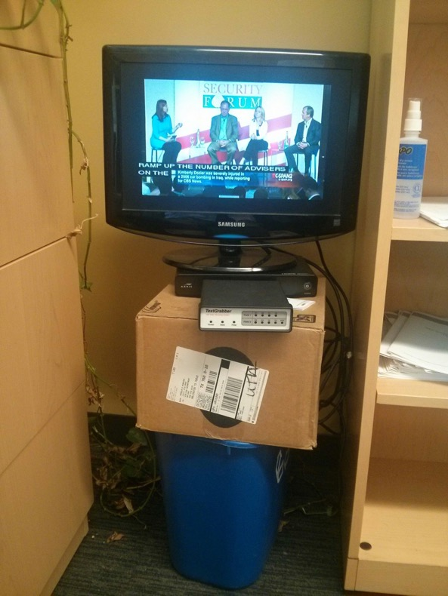
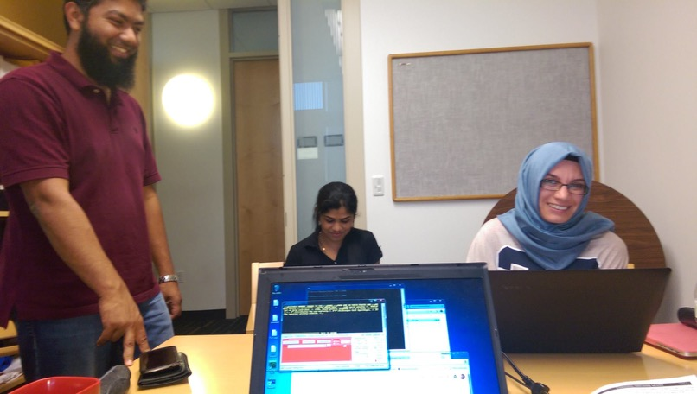

Slide 24
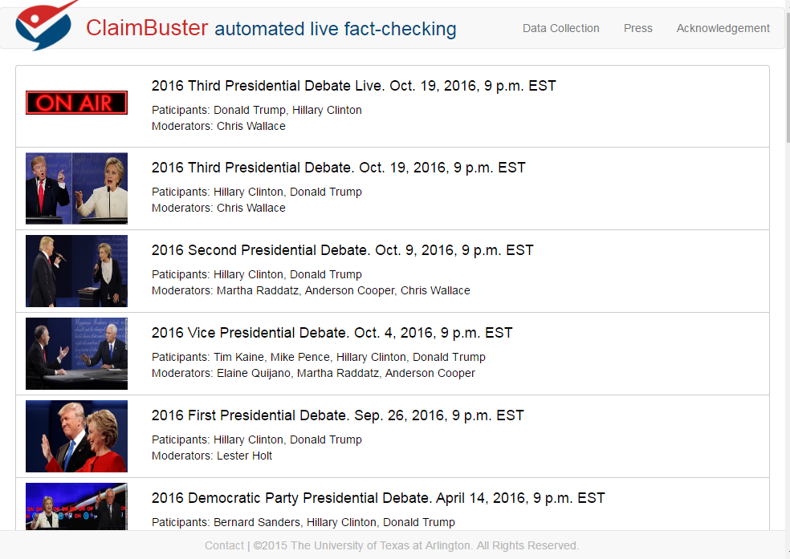
24

Slide 25
LSTM-based Model for Claim Spotting
Model based on an LSTM (long short-term memory) network
Tested several different word embeddings but found no significant difference in overall performance
Different embeddings did have different affinities (i.e., some produce models which score text with numbers higher on average).
We used nonsensical sentences to make the model more resistant to attacks. The neural models outperformed the SVM model by 29% in precision and 12% in recall.

Slide 26
Adversarially Trained LSTM
Training the LSTM model on adversarial (modified) examples.
Adversarial noise (perturbations), designed to maximize the chance of misclassification by the network, was calculated using back-propagation.
Perturbation was applied to word-embeddings rather than directly to the input.

Slide 27

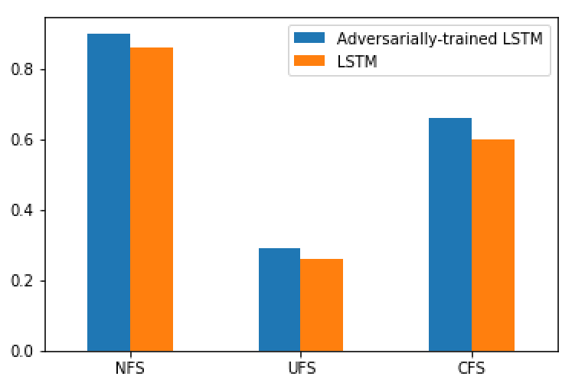
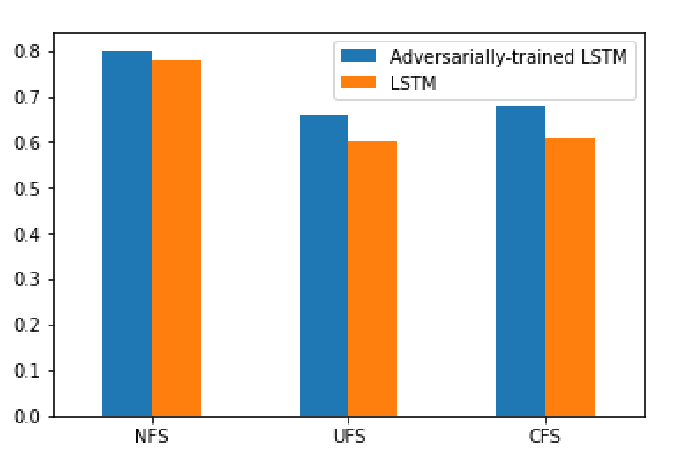
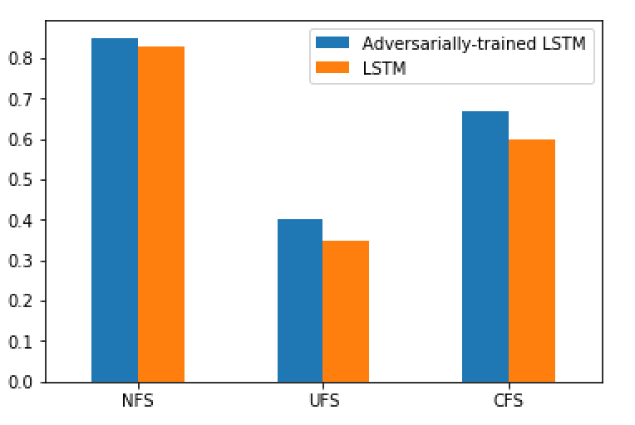
Adversarially Trained LSTM
Recall
Precision
F1-score

Slide 28
Claim Spotter
28

Slide 29

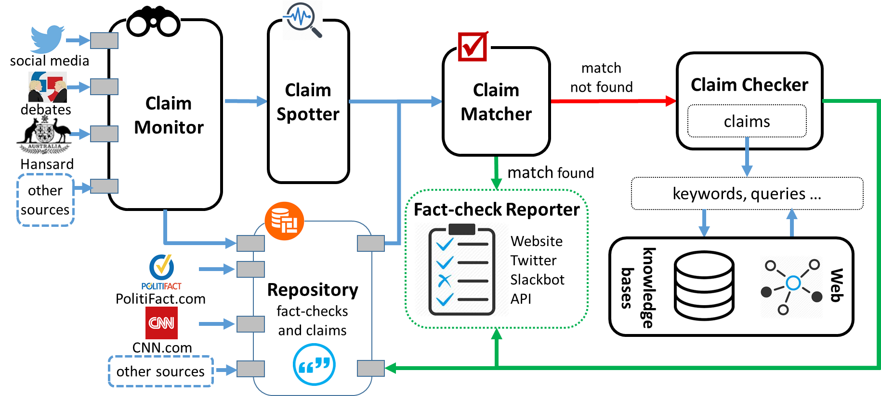
The First-ever End-to-end Fact-checking System
[CIKM15a, KDD17, VLDB17demo, IJCNN18]
* First Runner-Up, SIGMOD17 Student Research Competition
29

Slide 30
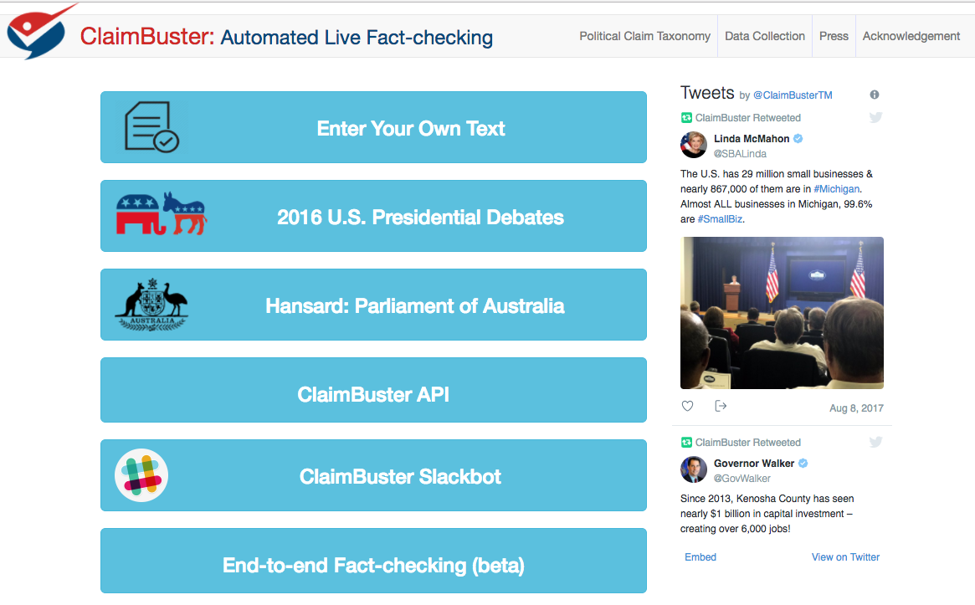
30

Slide 31
31

Slide 32

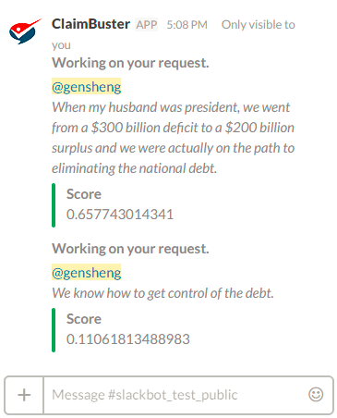
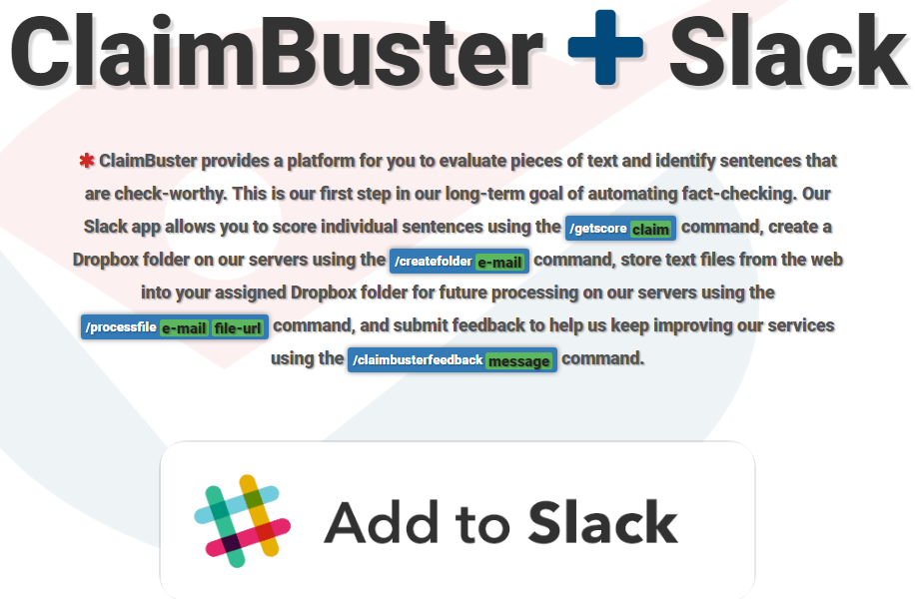
32

Slide 33
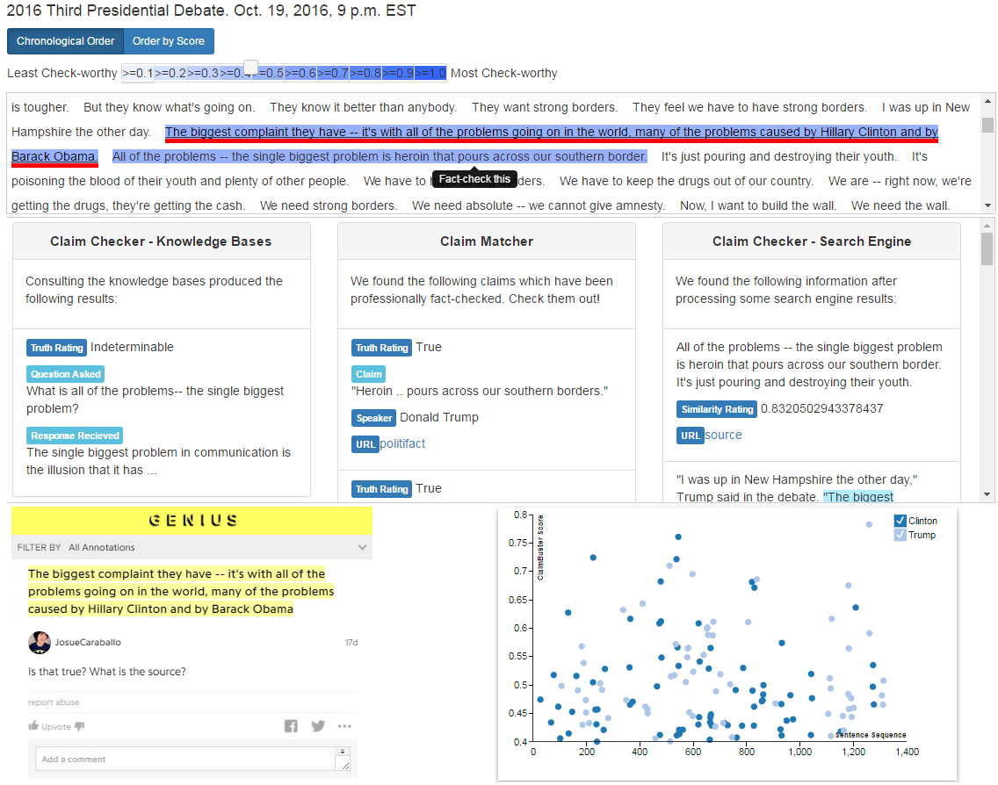
33

Slide 34
In the Press
34

Slide 35

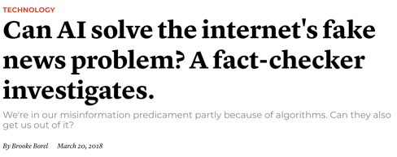
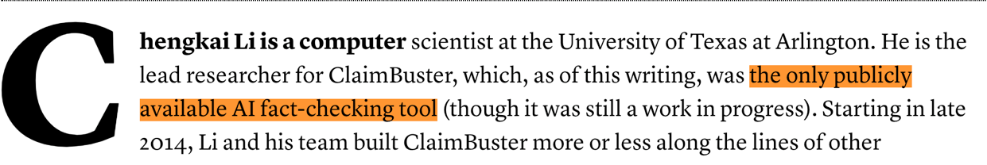

Slide 36
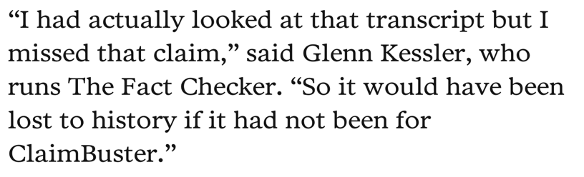
Duke Reporters’ Lab uses ClaimBuster API in creating daily newsletters that recommend to The Washington Post, New York Times, PolitiFact, and other fact-checkers the most check-worthy claims in CNN programs, Tweets, Facebook ports, and the Congressional Record.

Slide 37
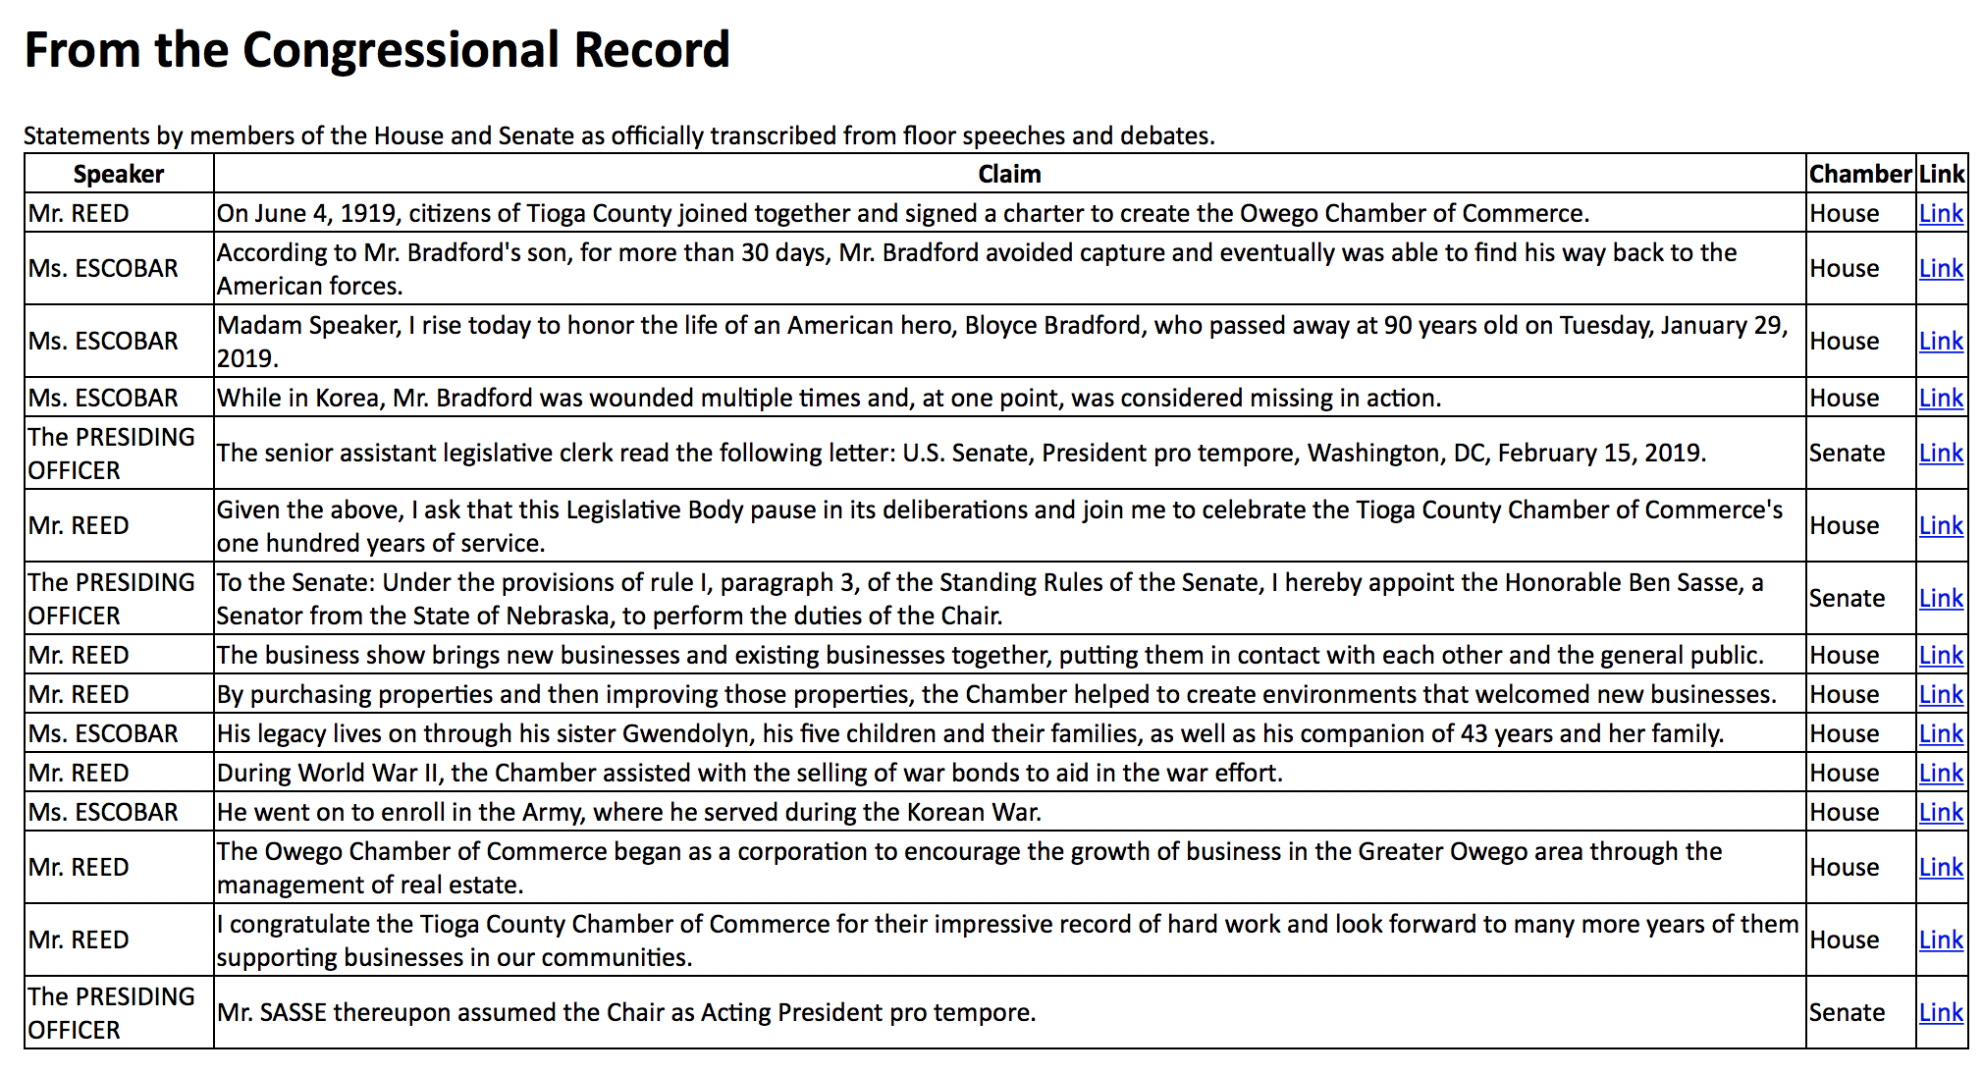

Slide 38
Outline
A Brief History of our Computation + Journalism Research
Computational Journalism
Data-driven fact-checking (ClaimBuster)
Other ongoing fact-checking Projects
Exceptional fact finding (FactWatcher, Maverick)
Graph Data Usability (Orion, GQBE, TableView, Maverick)

Slide 39
Claim-related Frames

Slide 40
Modeling Factual Claims
An extension of FrameNet (Baker et. al., 1998) for structured and semantic modeling of factual claims.
Capture various aspects of a factual claim: domain and topic, entities involved and their relationships, quantities, comparisons, aggregate structures ...
Useful for various steps in automating fact-checking: detecting factual claims, matching claims with fact-checks, translating claims to structured queries, ...

Slide 41
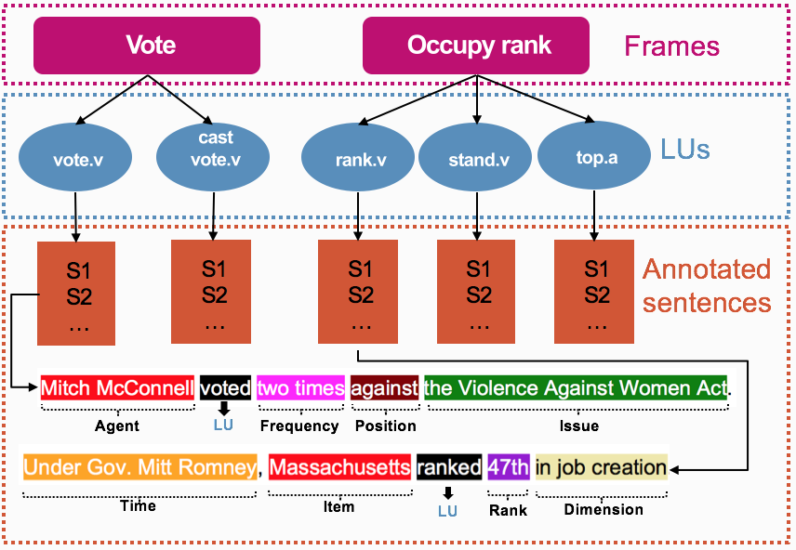
Figure: Vote and Occupy rank frames along with their LUs.
Notes:
An exemplified sentence for vote and rank Lus with color-coded frame annotations below. Labels below each sentence are frame specific frame
elements (FEs).

Slide 42
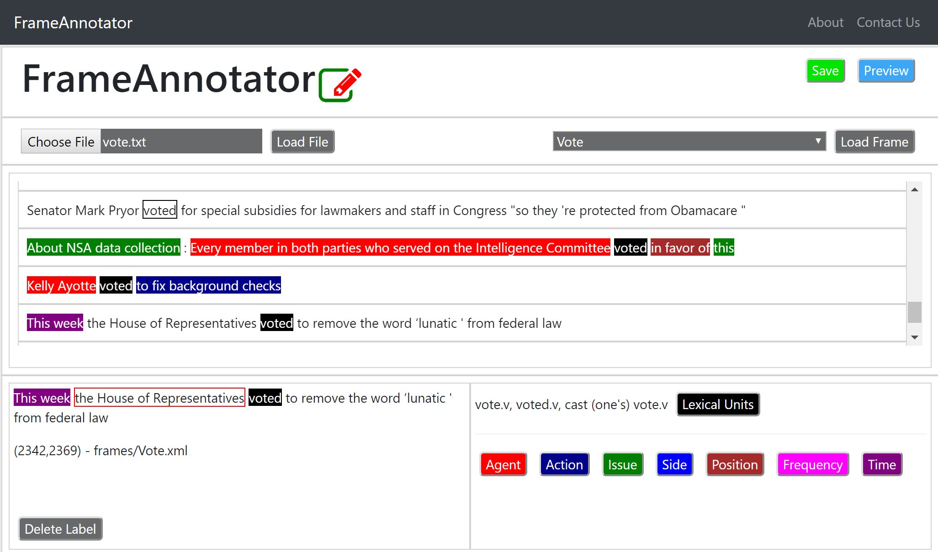

https://idir-server3.uta.edu/frameannotator/

Slide 43
ClaimPortal
Integrated Monitoring, Searching, Checking, and Analytics of Factual Claims on Twitter

Slide 44
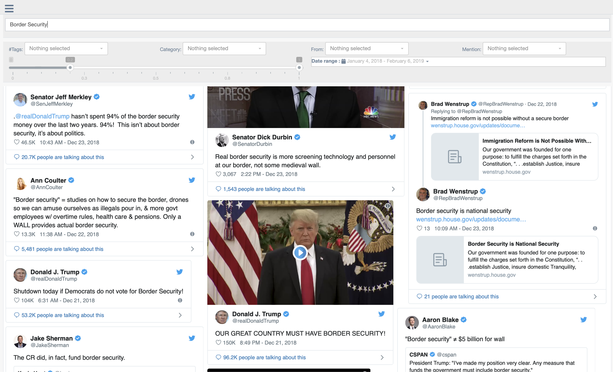

https://idir-server3.uta.edu/claimportal/frontendv2/production/

Slide 45
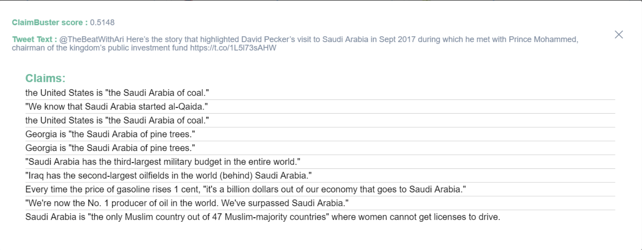

Slide 46
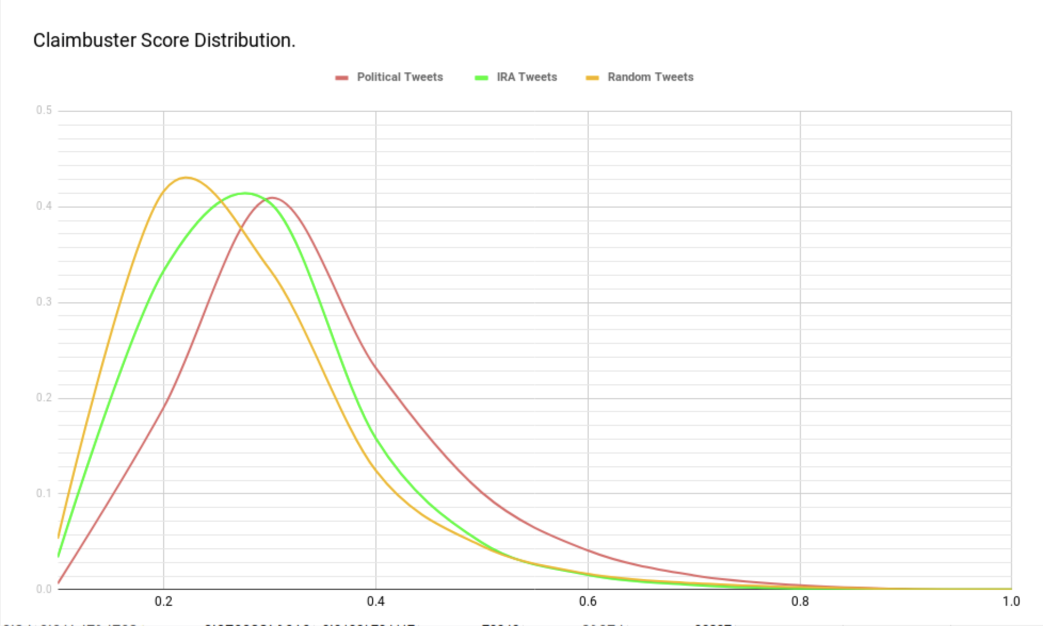

Slide 47

Claim Matching
Does
Textual Entailment help Claim Matching?

Slide 48
Outline
A Brief History of our Computation + Journalism Research
Computational Journalism
Data-driven fact-checking (ClaimBuster)
Other ongoing fact-checking Projects
Exceptional fact finding (FactWatcher, Maverick)
Graph Data Usability (Orion, GQBE, TableView, Maverick)

Slide 49
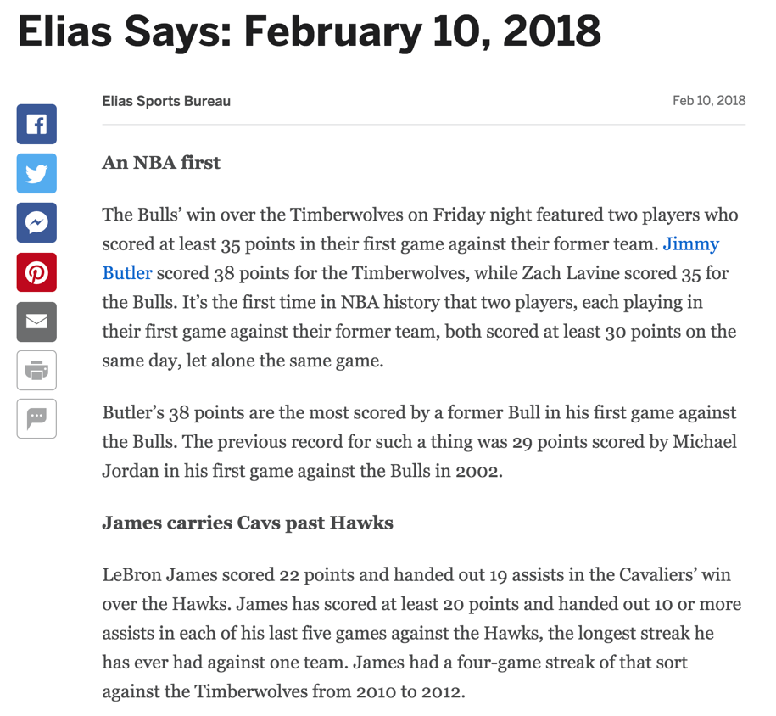

Slide 52
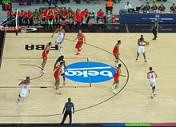
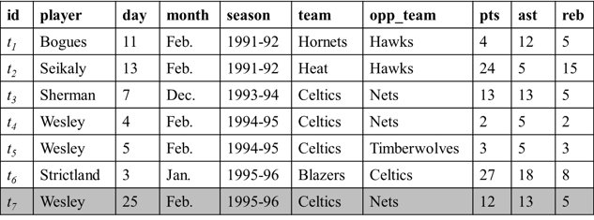
Exceptional Fact Finding
New tuple appended to database
Real-world event (sports, transportation, crime, weather, finance, social media)
Wesley had 12 points, 13 assists and 5 rebounds on February 25, 1996 to become the first player with a 12/13/5 (points/assists/rebounds) in February.
Fact-finding algorithms
Number-based facts make news stories more engaging
http://en.wikipedia.org/wiki/Basketball

Slide 53


FactWatcher
idir.uta.edu/factwatcher
Excellent
Demo Award

Slide 54
Fact-finding Algorithms
FactWatcher [VLDB14 demo]
[ICDE14] Situational Facts: “No other player scored more pts and reb against DAL than Jordan.”
[KDD12] One-of-the-Few: “Jordan scored 10 pts & 10 reb. Only 3 others had similar performance.”
[KDD11] Prominent Streaks: “The Nikkei 225 closed below 10000 for the 12th consecutive week, the longest such streak since June 2009.”
[TKDD14] General Prominent Streaks: “James has scored at least 20 points and handed out 10 or more assists in each of his last five games against the Hawks, the longest streak he has ever had against one team.”
Frequent Episode Mining [ICDE15]

Slide 55

Fact-finding Algorithms
Many interesting facts in the real-world can be modeled as various types of skyline points.
The gist of fact-finding is to efficiently, incrementally maintain skyline points over ever-changing data, while considering constraints such as selection conditions.
Stephan Börzsönyi, Donald Kossmann, Konrad Stocker: The Skyline Operator. ICDE 2001: 421-430

Slide 56

Modeling Situational Facts
“Paul George had 21 points, 11 rebounds and 5 assists to become the first Pacers player with a 20/10/5 (points/rebounds/assists) game against the Bulls since Detlef Schrempf in December 1992.”
(http://espn.go.com/espn/elias?date=20130205)

Slide 57

Modeling Situational Facts
“Paul George had 21 points, 11 rebounds and 5 assists to become the first Pacers player with a 20/10/5 (points/rebounds/assists) game against the Bulls since Detlef Schrempf in December 1992.”
(http://espn.go.com/espn/elias?date=20130205)

Slide 58
Modeling Situational Facts
Dimension space: D={d₁,… ,d_{n}}
Measure space: M ={m₁,… ,m_{s}}
id | player | day | month | season | team | opp_team | pts | ast | reb
t₁ | Bogues | 11 | Feb. | 1991-92 | Hornets | Hawks | 4 | 12 | 5
t₂ | Seikaly | 13 | Feb. | 1991-92 | Heat | Hawks | 24 | 5 | 15
t₃ | Sherman | 7 | Dec. | 1993-94 | Celtics | Nets | 13 | 13 | 5
t₄ | Wesley | 4 | Feb. | 1994-95 | Celtics | Nets | 2 | 5 | 2
t₅ | Wesley | 5 | Feb. | 1994-95 | Celtics | Timberwolves | 3 | 5 | 3
t₆ | Strictland | 3 | Jan. | 1995-96 | Blazers | Celtics | 27 | 18 | 8
Τ
Skyline maintenance + Data Cube/OLAP
a₁
b₁
c₁
a₁,b₁
a₁,c₁
b₁,c₁
a₁,b₁,c₁

Slide 59
Outline
A Brief History of our Computation + Journalism Research
Computational Journalism
Data-driven fact-checking (ClaimBuster)
Other ongoing fact-checking Projects
Exceptional fact finding (FactWatcher, Maverick)
Graph Data Usability (Orion, GQBE, TableView, Maverick)

Slide 60
Maverick: Discovering Exceptional Facts
from Knowledge Graphs
[SIGMOD18, VLDB18demo]

Slide 61

Exceptional Facts
Denzel Washington followed Sidney Poitier as only the second black to win the Best Actor award.
Entity of Interest
Denzel Washington
Context
Best Actor award winners
Attributes
Ethnicity
Peculiar value
African American
(only two satisfy)
Notes:
And the context.
In each exceptional fact, among all the entities, in the context, the entity of interest is one of the few, or even the only one that bears a particular value combination on the qualifying attributes.
In the example of Denzel Washington, we can paraphrase the facts as: Among all the best actors winners, Denzel Washington is one of the only two person whose ethnicity is African American.

Slide 62
Exceptional Facts
Denzel Washington followed Sidney Poitier as only the second black to win the Best Actor award.
Entity of Interest
Denzel Washington
Given an entity x
find
Context
Best Actor award winners
A context
Attributes
Ethnicity
A set of attributes
(subspace)
Peculiar value
African American
(only two satisfy)
Notes:
And the context.
In each exceptional fact, among all the entities, in the context, the entity of interest is one of the few, or even the only one that bears a particular value combination on the qualifying attributes.
In the example of Denzel Washington, we can paraphrase the facts as: Among all the best actors winners, Denzel Washington is one of the only two person whose ethnicity is African American.

Slide 63
Exceptional Facts
Denzel Washington followed Sidney Poitier as only the second black to win the Best Actor award.
Entity of Interest
Denzel Washington
Given an entity x
find
such that
Context
Best Actor award winners
A context
the context has many entities, including x
Attributes
Ethnicity
A set of attributes
(subspace)
Peculiar value
African American
(only two satisfy)
x bears a peculiar value w.r.t. the subspace (few in the context have the value)
Notes:
And the context.
In each exceptional fact, among all the entities, in the context, the entity of interest is one of the few, or even the only one that bears a particular value combination on the qualifying attributes.
In the example of Denzel Washington, we can paraphrase the facts as: Among all the best actors winners, Denzel Washington is one of the only two person whose ethnicity is African American.

Slide 64

Exceptional Facts
Denzel Washington followed Sidney Poitier as only the second black to win the Best Actor award.
This was Brazil's first own goal in World Cup history.
Hillary Clinton becomes first female presidential nominee.

Slide 65

Applications
Computational Journalism
Fact-finding
Fact-checking
The first female presidential nominee was Victoria Woodhull, not Hillary Clinton (snopes.com)
Data Cleaning
Recommendation Systems
Friends, news, and product promotion
Notes:
As we can see such statements all over the news articles, discovery of exceptional facts is useful to various important applications.
For example, journalists are interested in monitoring and discovering attention-seizing factual statements like Denzel Washington’s Example.
In fact-checking, fact-checkers can compare the statements made by humans with automatically discovered facts. For example, on snopes.com, there is a fact-check about whether Hillary Clinton is the first female presidential nominee or not.
Exceptional facts can help promote friends, news and product in various recommend systems. For example, search engine can promote their search results by showing exceptional facts. If you search Willis Tower on Google, you may see the “did you know” sections which tells one of its exceptional facts.
When the discovered facts are inconsistent with known truth or apparent common sense, it reveals incomplete data or data errors. Such insights aid knowledge base cleaning and completion.

Slide 66

Exceptional Facts from Knowledge Graphs
What is exceptional about G1?
Notes:
In the following, I will show our formal definition of attributes, subspaces, contexts, and the exceptional fact discovery problem.
The attributes of an entity are the entity’s incoming/outgoing edge labels and the attribute values are the entity’s direct neighbors
For example, entity S1 has two attributes: score-by, play-for. The values of the two attributes are G1, BRA, respectively.
A subspace is a subset of attributes.

Slide 67
Modeling
Attributes: labels of incoming/outgoing edges
Values: direct neighbors
Subspace: a subset of attributes
G1. awarded-to = CRO
Notes:
In the following, I will show our formal definition of attributes, subspaces, contexts, and the exceptional fact discovery problem.
The attributes of an entity are the entity’s incoming/outgoing edge labels and the attribute values are the entity’s direct neighbors
For example, entity S1 has two attributes: score-by, play-for. The values of the two attributes are G1, BRA, respectively.
A subspace is a subset of attributes.

Slide 68

Modeling
Context: entities sharing some common characteristics
Defined by a pattern-variable pair
P₁
Goals scored by Brazilian players
Notes:
A context is a set of entities sharing some common characteristics. We express a context by a pair of a pattern and a variable in the pattern.
For example, P1 in the figure and the variable ?g define a context which consists of goals scored by Brazilian players.

Slide 69
Modeling
Context: entities sharing some common characteristics
Defined by a pattern-variable pair
P₁
Goals scored by Brazilian players
Notes:
A context is a set of entities sharing some common characteristics. We express a context by a pair of a pattern and a variable in the pattern.
For example, P1 in the figure and the variable ?g define a context which consists of goals scored by Brazilian players.

Slide 70
Modeling
Context: entities sharing some common characteristics
Defined by a pattern-variable pair
P₁
Goals scored by Brazilian players
Notes:
A context is a set of entities sharing some common characteristics. We express a context by a pair of a pattern and a variable in the pattern.
For example, P1 in the figure and the variable ?g define a context which consists of goals scored by Brazilian players.

Slide 71
Modeling
What is exceptional about G1?
Among all the goals scored by BRA players, G1 is the only own goal.
Notes:
A context is a set of entities sharing some common characteristics. We express a context by a pair of a pattern and a variable in the pattern.
For example, P1 in the figure and the variable ?g define a context which consists of goals scored by Brazilian players.

Slide 72

Problem Formulation
Input
Entity of interest v₀
Exceptionality function $χ$
Result size k
Output
Top-k (context, subspace) pairs with regard to $χ$, in which v₀ stands out
Notes:
We now are ready to define the problem of exceptional fact discovery.
Given an entity in the knowledge, an exceptionality function chi, and an integer k, the objective of exceptional fact discovery is to find top-k highest scored context-subspace pairs.

Slide 73


Challenges
Space of attributes: $O(2^{|A_{v_{0}}|})$
Space of patterns: $Ω(2^{|V_{G}|})$
{}
gender
ethnicity
profession
gender, ethnicity
gender, profession
ethnicity, profession
gender, ethnicity, profession
Notes:
The main computational challenge of the problem is that we have to explore two extremely large search spaces, one of subspaces, one of patterns. It is challenging to prune subspaces and patterns, because the exceptionality scores usually do not have anti-monotone property.

Slide 74

Related work
Outlier detection
Different goal: find a set of objects from a dataset
Outlying explanation is not a focus
Outlying aspect mining
Single table model, not suitable for graph-based data
Extremely large and sparse table
Conjunctive queries $≠$ Pattern queries
Set values
Notes:
There are two major areas that are related to our work: outlier detection, and outlying aspect mining.
Outlier detection is to find a set of objects from a dataset, it does not focus on explaining why outliers are outlying. While our work tries to explain why an object is exceptional by showing the pairs of contexts and subspaces where the object is highly-scored.
In general, we share the same goal with outlying aspect mining, which focuses on outlying explanation for a given object. However, existing techniques adopts a single table model, which is not suitable for graph-based data, such as knowledge graphs. First, a table that models a graph can be extremely large and sparse, given the sizes and the variety of relationships in a knowledge graph. Second, only handful methods consider contextual outlying explanation. The existing techniques model contexts using conjunctive queries. In graphs, conjunctive queries are not sufficient. Third, existing techniques do not consider set values in defining contexts. However, set values in graphs are very common.

Slide 75

Maverick [SIGMOD2018]
Notes:
We, then, propose a beam search based framework, Maverick, to discover exceptional facts about entities.
The search is accomplished mainly by three components: context-evaluator, exceptionality evaluator, and pattern generator.
Maverick maintains a beam, which is a fixed-size priority queue,
For each pattern in the beam, context evaluator evaluates the pattern to obtain its matches and contexts.
w.r.t each context, the exceptionality evaluator evaluates the degree of exceptionality of the entity, and outputs top-k context-subspace pairs
Pattern generator then finds all the children of the current pattern. Basically, it maintains a tree of pattern, which we call pattern search tree. The top children in each level will become the new beam at next iteration.

Slide 76




Exceptionality Function $χ$
$$χ\left(v, A, C\right)∈ℛ$$
outlierness ($χ_{o}$) [Angiuli2009TODS], one-of-the-few($χ_{f}$) [Wu2012KDD], isolation scores ($χ_{i}$) [Liu2008ICDM]
Upper bound function
Theorem 4.2
Theorem 4.3
Theorem 4.4
Notes:
As mentioned previously, the exceptionality evaluator is responsible for evaluating the given entity’s degree of exceptionality, with regard to a given context.
An exceptionality function is a real function, and the inputs of the function are an entity, a subspace and a context.
Note that Maverick allows users to use any outlyingness/interestingness functions based on their applications. For example, one can use outlierness, or one-of-the-few, or isolation scores, and many others.
The exceptionality of an entity is the highest exceptionality score among all the subspaces

Slide 77


Match–based Pattern Generation
Construct Partial Order of Valid Patterns
Notes:
However, one may realize that, while every pattern is a super graph of its parent, every match to the pattern is also a super graph of a match to the parent pattern.
For example, P11 is a child of P9, so its match M10 must be a super graph of a match to P9, for example M9.

Slide 78

Datasets and Experiments
WCGoals
Created based on FIFA.com
11 node types, 13 edge types
49,078 nodes, 158,114 edges
Film-Award
A subgraph of Freebase
95 node types, 117 edge types
5,437,628 nodes, 10,879,448 edges
Notes:
We have conduct experiments on two real world knowledge graphs. We have used larger graphs than the ones used by the time of my proposal.
The first is the FIFA World Cup graph. It is created based on the information on FIFA.com
The second is a subgraph of freebase, which includes two domains, film, and award.

Slide 79
Outline
A Brief History of our Computation + Journalism Research
Computational Journalism
Data-driven fact-checking (ClaimBuster)
Other ongoing fact-checking Projects
Exceptional fact finding (FactWatcher, Maverick)
Graph Data Usability (Orion, GQBE, TableView, Maverick)

Slide 80
Tackling Graph Data Usability Challenges
Challenges
Massive, complex graphs; millions of entities; billions of edges.
Requires substantial understanding of schema and data and complex pre-processing, before one can fetch information or gain insights from data.
Objectives
Make it easy to understand, query, explore, and clean graph data.
Systems
GQBE [TKDE15, ICDE14demo]: graph query by example
Orion [VLDB15demo, SIGMOD17tutorial]: auto-suggestion for interactive query formulation
TableView [SIGMOD16, ICDE18demo]: generating preview tables for knowledge graphs
( * SIGMOD Most Reproducible Paper Award)
Maverick [SIGMOD18, VLDB18demo]: finding outliers and errors in graphs

Slide 81

Embedding-Based Knowledge Graph Completion

Slide 82


Slide 83

IDIR Projects and Demos
Demonstration Videos https://vimeo.com/channels/1024406
ClaimBuster (idir.uta.edu/claimbuster) Automated, live fact-checking
CrewScout (idir.uta.edu/crewscout) Expert team finding by skyline groups
ERQ: Entity-Relationship Query (idir.uta.edu/erq) Structured query on Wikipedia
Facetedpedia (idir.uta.edu/facetedpedia) Faceted search interface for Wikipedia
FactWatcher (idir.uta.edu/factwatcher) Fact-finding from real-world events
GQBE (idir.uta.edu/gqbe) Graph query by example
Orion (idir.uta.edu/orion) Auto-suggestion for interactive graph query formulation
TableView Generating preview tables for knowledge graphs
Maverick Exceptional fact finding from knowledge graphs
System idir.uta.edu/claimbuster
System idir.uta.edu/claimbuster

Slide 84
















Current IDIR Students
Ph.D. students
Farahnaz
Akrami
Fatma
Arslan
Israa
Jaradat
Damian
Jimenez
Shadekur
Rahman
Samiul
Saeef
Xiao
Shi
Theodora
Toutountzi
Zeyu
Zhang
M.S. students
B.S. students
Priyank
Arora
Sumeet
Lubal
Sarthak
Majithia
Daniel
Obembe
Sarbajit
Roy
Kyrell
Dixon
Jacob
Devasier

Slide 85
Graduated Students
Ph.D. students
Aditya Telang
2011 (co-advised) IBM Research India
Ning Yan
2013
Research Scientist
Huawei, Santa Clara
Naeemul Hassan
2016
Assistant Professor
University of Mississippi
Nandish Jayaram
2016
Pivotal
Gensheng Zhang
2017
Google
Afroza Sultana
2018
Teradata Lab
B.S. students
M.S. Thesis students
Josue Caraballo (2017)
Damian Jimenez (2017, UTA Ph.D.)
Long Ly (2015)
Sidharth Goyal (2015)
Huadong Feng (2014)
Raju Karki (2012)
Angus Helm (2010)
Aakash Tuli (2010)
Tulsi Chandwani (2017, Red Hat)
Abu Ayub Ansari Syed (2017)
Ishwor Timilsina (2017, Fidelity)
Nigesh Shakya (2017)
Rohit Bhoopalam (2016, Akamai)
Fatma Dogan (2015, UTA Ph.D.)
Minumol Joseph (2015, Capital One)
Ramesh Venkataraman (2014, Amazon)
Mahesh Gupta (2012, Electronic Arts)
Jijo Philip (2012, Cerner Corporation)
Avinash Bharadwaj (2011, Copper Labs)
Quazi (Sunny) Hasan (2010, Dematic)
Jared Ashman (2010, Ambit Energy)
Muhammad Safiullah (2008, Microsoft)

Slide 86
Collaborators
On current projects
Bill Adair (Duke, Public Policy)
Pankaj Agarwal (Duke)
Xiang Ao (Chinese Academy of Sciences)
Vassilis Athitsos (UTA)
Sourav Bhowmick (Nanyang Technological University )
Byron Choi (Hong Kong Baptist University)
Christoph Csallner (UTA)
Peter Fray (University of Technology Sydney, Journalism)
James Hamilton (Stanford, Communication)
Naeemul Hassan (Mississippi)
Wei Hu (Nanjing University)
Angela Lee (UTD, Media)
Zhiqiang Lin (Ohio State)
Ping Luo (Chinese Academy of Sciences)
Mark Tremayne (UTA, Communication)
Jun Yang (Duke)
Cong Yu (Google Research)
On past projects
Sharma Chakravarthy (UTA)
Fei Chen (LinkedIn)
Shimin Chen(Chinese Academy of Sciences)
Gautam Das (UTA)
Chris Ding (UTA)
Ramez Elmasri (UTA)
Leonidas Fegaras (UTA)
Arijit Khan (Nanyang Technological University)
Min Wang (Visa Research)
Xifeng Yan (UCSB)
Nan Zhang (Penn State)

Slide 87






Funding Sponsors
Entrepreneurship

Slide 88
Thank you!

Slide 89
Feature Extraction
Word:
state, legislature, 87, percent, democrat
Sentiment: 0.032
I was in a state where my legislature was 87 percent Democrat.
Part-of-Speech:
Noun
Entity Type:
Quantity
Concept:
United States
89

Slide 90
Feature Importance
6615 features in total
Used a Random Forest Classifier to calculate the importance of each feature.
Word | percent; people; jobs
POS Tag | noun; cardinal number; past tense; preposition
Entity Type | Quantity; Country; FieldTerminology; Person
Concept | United States Senate; Barack Obama
Sentiment
90

Slide 91
Coder Quality
91

Slide 92
Classification Accuracy [IJCNN18]
Algorithm | Features | P NFS | P UFS | P CFS | P AVG* | R NFS | R UFS | R CFS | R AVG* | F NFS | F UFS | F CFS | F AVG*
SVM | Parts of Speech | 0.873 | 0.430 | 0.724 | 0.813 | 0.925 | 0.240 | 0.671 | 0.827 | 0.898 | 0.307 | 0.696 | 0.818
CNN | Google News¹ | 0.874 | 0.649 | 0.775 | 0.838 | 0.951 | 0.250 | 0.725 | 0.859 | 0.911 | 0.361 | 0.749 | 0.842
RNN | GLoVE² | 0.900 | 0.397 | 0.811 | 0.853 | 0.928 | 0.457 | 0.712 | 0.852 | 0.914 | 0.425 | 0.758 | 0.851
P: Precision | R: Recall | F: F1-Score
*: Average (AVG) is weighted based on the distribution of the number of labels in each class.
1: Pre-trained vectors trained on part of Google News dataset (about 100 billion words). The model contains 300-dimensional vectors for 3 million words and phrases. https://code.google.com/archive/p/word2vec/
2: Global Vectors for Word Representation using The Common Crawl corpus which contains petabytes of data collected over the last 7 years. https://nlp.stanford.edu/projects/glove/
92

Slide 93
Defining New Frames
Collected fact-checked claims from PolitiFact
Examined a subset of these claims one by one
Grouped claims similar in nature
Created new frames for a claim group if it doesn’t exist in FrameNet
20 frames (13 newly created)
900 labelled factual claims

Slide 94
Preliminary Experiments: Claim Detection
Task:
Claim spotting (identifying factual claims) as frame identification task
Used open-sesame for learning frame identification models
Training data: 7 existing frames (from FrameNet itself, already labelled), 3 new frames (from PolitiFact, labelled by ourselves)
Test data: 7 existing frames + 3 new frames (from Share the Facts, labelled by ourselves)

Slide 95

Preliminary Experiments: Claim Spotting
New frames Uniqueness of trait and Vote performed on par with existing frames
Model’s performance could be improved with more training data
Developed a frame annotator tool to annotate more sentences
Notes:
“Recurring action”, “Uniqueness of trait”, and “Vote“ are newly created frames

Slide 96
ClaimPairs Dataset
ID | Premise Claim (P) | Hypothesis Claim (H) | Entail. | Contra. | Match.
1 | Hostages were released as soon as Ronald Reagan took office because Iran perceived that America was ”no longer under the command of someone weak.” | It’s worth remembering Iran released our hostages the day Ronald Reagan was sworn into office. | 1 | 0 | 1
2 | While our people work longer hours for lower wages, almost all new income goes to the top 1 percent. | I’m running for president because our economy is rigged because working people are working longer hours for lower wages and almost all of new wealth and income being created is going to the top one percent. | 0 | 0 | 0
3 | When President Obama took office, we were losing 700,000 jobs a month. Now we’ve had job growth, I think, for 24 consecutive months. | When President Obama came into office we were losing 800,000 jobs a month, 800,000 jobs a month. | 0 | 1 | 1
Notation Key
Entail.: Entailment,
Contra.: Contradiction,
Match.: Matching

Slide 97
Claim Matching Experiment Results
Algorithms | p M/En/Con | p Neutral | r M/En/Con | r Neutral | F1 M/En/Con | F1 Neutral
EditDistance (Lemma) | 0.49 / 0.41 / 0.07 | 0.97 / 0.97 / 0.99 | 0.81 / 0.82 / 0.77 | 0.88 / 0.86 / 0.80 | 0.61 / 0.55 / 0.13 | 0.92 / 0.91 / 0.89
EditDistance (Lemma+WN) | 0.54 / 0.47 / 0.07 | 0.96 / 0.97 / 0.99 | 0.77 / 0.80 / 0.64 | 0.91 / 0.89 / 0.83 | 0.64 / 0.59 / 0.13 | 0.93 / 0.93 / 0.90
PSO EditDistance (Token) | 0.48 / 0.41 / 0.06 | 0.97 / 0.97 / 0.99 | 0.79 / 0.81 / 0.68 | 0.88 / 0.86 / 0.80 | 0.60 / 0.55 / 0.12 | 0.92 / 0.92 / 0.89
PSO EditDistance (Token+WN) | 0.54 / 0.47 / 0.07 | 0.96 / 0.97 / 0.99 | 0.74 / 0.76 / 0.64 | 0.91 / 0.90 / 0.84 | 0.63 / 0.58 / 0.13 | 0.93 / 0.93 / 0.91
TIE (OpenNLP) | 0.96 / 0.95 / 0.02 | 0.92 / 0.94 / 0.98 | 0.38 / 0.44 / 0.05 | 1.00 / 1.00 / 0.95 | 0.54 / 0.60 / 0.03 | 0.96 / 0.97 / 0.97
TIE (WN+VO) | 0.47 / 0.45 / 0.02 | 0.93 / 0.95 / 0.98 | 0.55 / 0.62 / 0.18 | 0.91 / 0.91 / 0.85 | 0.51 / 0.52 / 0.04 | 0.92 / 0.93 / 0.91
AdArte | 0.35 / 0.30 / 0.06 | 0.95 / 0.96 / 0.99 | 0.70 / 0.70 / 0.73 | 0.81 / 0.80 / 0.76 | 0.47 / 0.41 / 0.11 | 0.88 / 0.87 / 0.86
P1EDA | 0.61 / 0.56 / 0.04 | 0.95 / 0.97 / 0.98 | 0.61 / 0.76 / 0.32 | 0.94 / 0.93 / 0.86 | 0.64 / 0.65 / 0.08 | 0.94 / 0.95 / 0.92
Notation Key
Entail.: Entailment,
Contra.: Contradiction,
Match.: Matching

Slide 98

Pattern Generator (PG)
Notes:
Conceptually, Maverick organizes search space of patterns as a partial order based on the subsumption relation on patterns.
In the partial order, each child of a pattern is an immediate super graph of the pattern.
For example, in the graph of patterns as shown, both P5 and P6 are super-graph and thus, children of P1.

Slide 99

Maverick [VLDB2018demo]
Notes:
We, then, propose a beam search based framework, Maverick, to discover exceptional facts about entities.
The search is accomplished mainly by three components: context-evaluator, exceptionality evaluator, and pattern generator.
Maverick maintains a beam, which is a fixed-size priority queue,
For each pattern in the beam, context evaluator evaluates the pattern to obtain its matches and contexts.
w.r.t each context, the exceptionality evaluator evaluates the degree of exceptionality of the entity, and outputs top-k context-subspace pairs
Pattern generator then finds all the children of the current pattern. Basically, it maintains a tree of pattern, which we call pattern search tree. The top children in each level will become the new beam at next iteration.

Slide 100

Graph Data Usability

